Slide 1
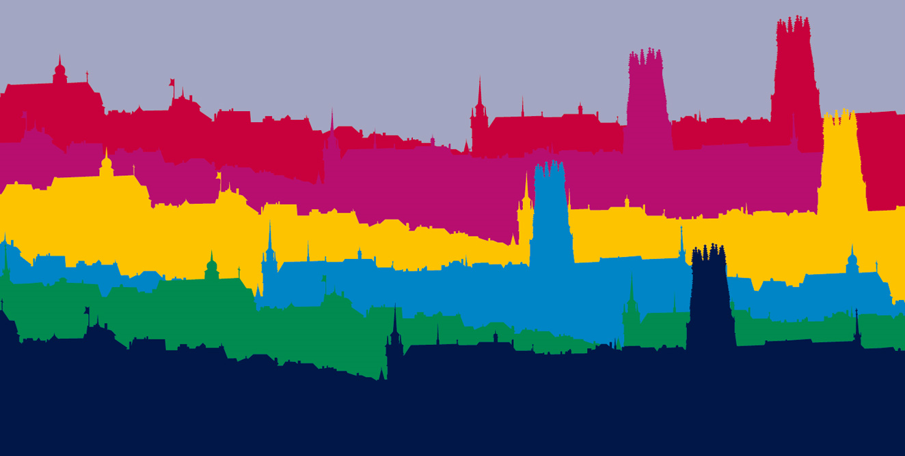
BIENVENUE à la Faculté des SES
WILLKOMMEN an der SES-Fakultät
Pour le bon déroulement de la séance, merci de bien vouloir éteindre votre caméra et micro !
Si vous avez des questions, veuillez les poser sur le chat de la séance TEAMS et nous nous ferons un plaisir de vous répondre
Um einen guten Ablauf der MS-Teams-Sitzung zu gewährleisten, schalten Sie bitte Ihre Kamera und Ihr Mikrofon aus !
Wenn Sie Fragen haben, stellen Sie diese bitte über den TEAMS-Chat und wir werden uns freuen, Ihnen zu antworten

Slide 2
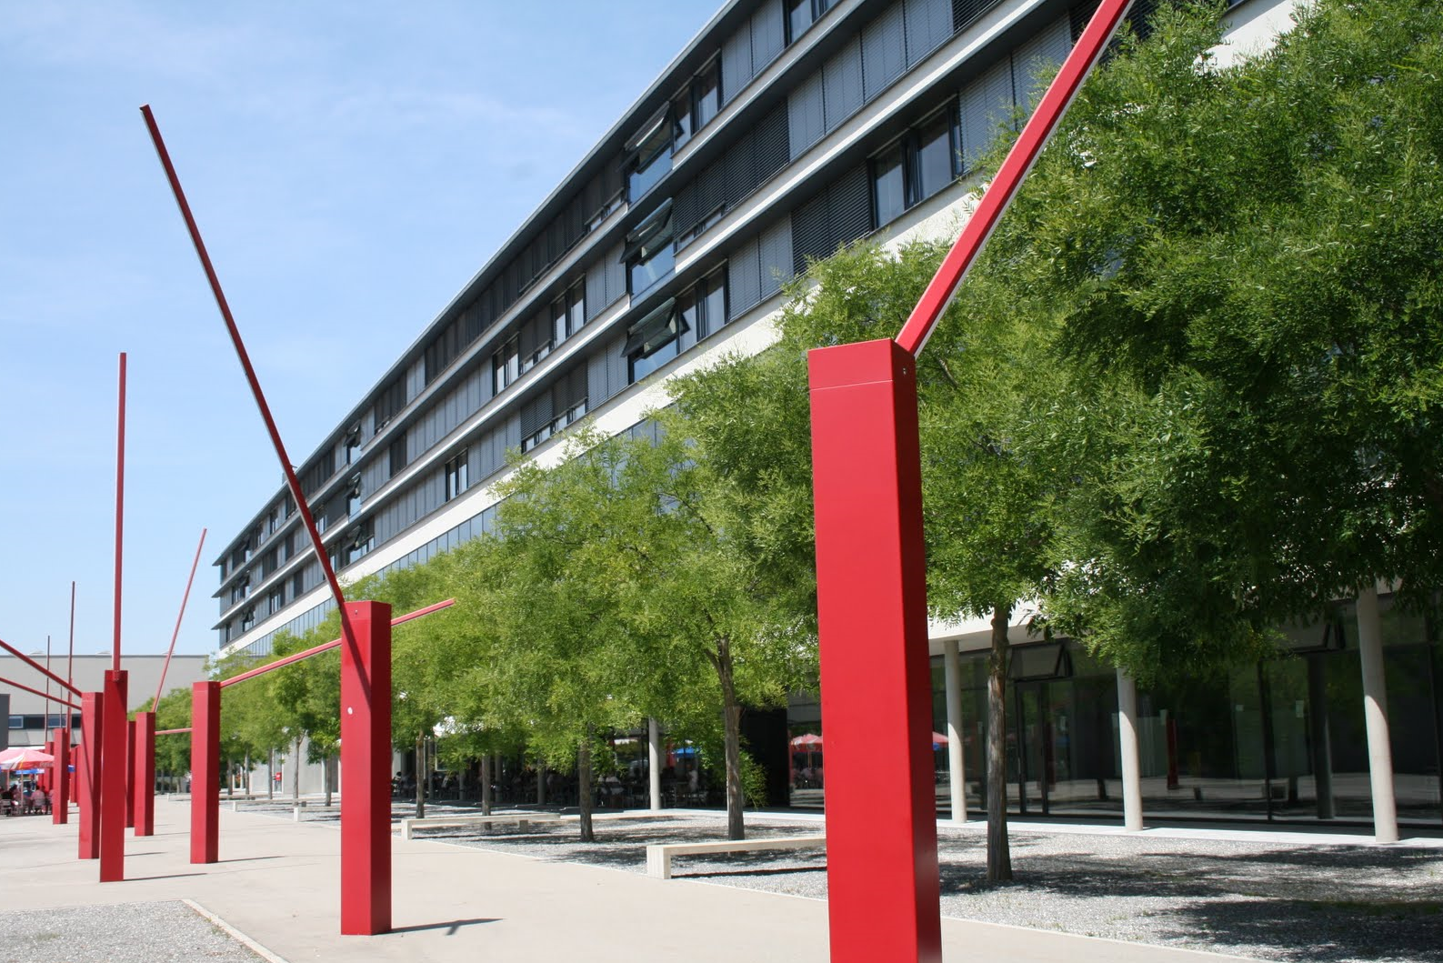
The Business Masters at the University of Fribourg:
Master in Management
Master in Accounting and Finance
Master in International and European Business
Master in Marketing Master Evening, March 09, 2021

Slide 3
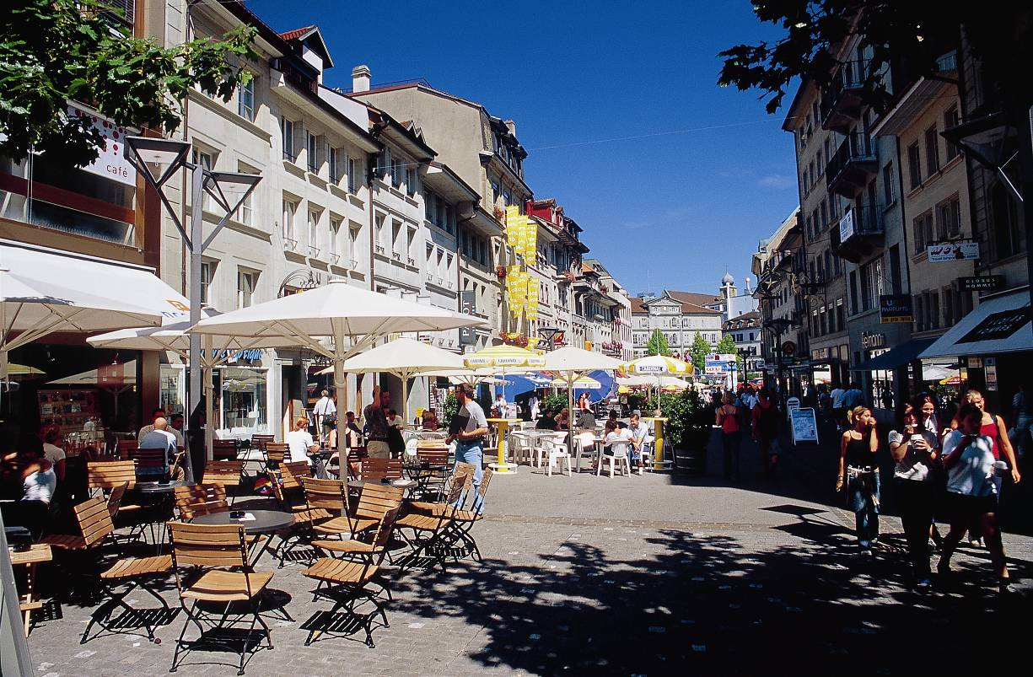
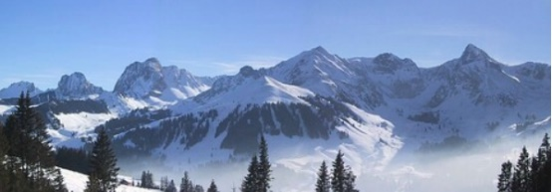
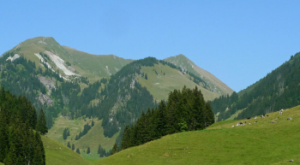
Why doing your Master in Management in Fribourg?
Fribourg is the perfect student city:
affordable cost of living
very nice downtown atmosphere
many cafés, restaurants, theaters, clubs, cinemas, …
lots of opportunities for leisure activities
mountains and lakes nearby

Slide 4
Why doing your Master in Management in Fribourg?
The strengths and unique characteristics of our department and our masters:
✓
International research that is continuously integrated in the master courses
✓
Cooperation with companies: projects, guest speaker presentations in the courses

Slide 5
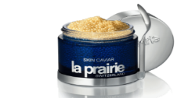
Why doing your Master in Management in Fribourg?
Examples of guest speaker presentations in the master courses:
Erland Brügger CEO, Rivella
Jan Jenisch CEO, LafargeHolcim
Georges Kern CEO, IWC
Stephan Heissler Direktor, Liebherr Gruppe
Thomas Truttmann Vice President Marketing, McDonald’s Schweiz
Reto Aeschbacher
CMO and Brand Manager, Scott Sports
Pierre Wenger Managing Director, Microspot & Interdiscount
Robin Barraclough Chief Marketing Officer, Emmi
Markus Vogt Head of Sales & Marketing, Ricola
Kurt Haerri Head Global Marketing, Schindler
Werner Dirks General Manager, La Prairie Schweiz
Hartmut Scheffler Managing Director, Kantar TNS

Slide 6
Why doing your Master in Management in Fribourg?
The strengths and unique characteristics of our department and our masters:
✓
International research that is continuously integrated in the master courses
✓
Cooperation with companies: projects, guest speaker presentations in the courses
✓
Highly motivated professors: We love teaching and interacting with our students!

Slide 7
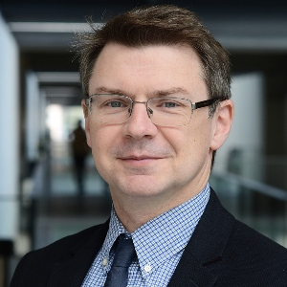
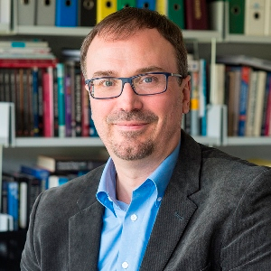
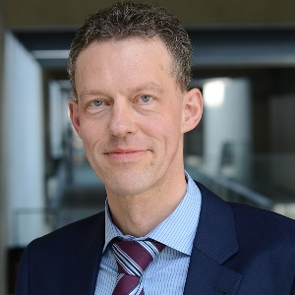
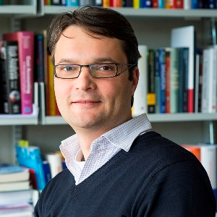
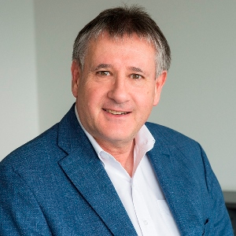
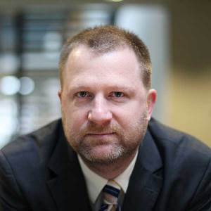
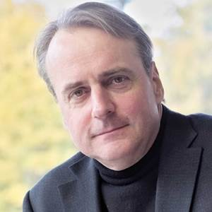
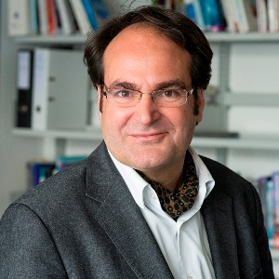
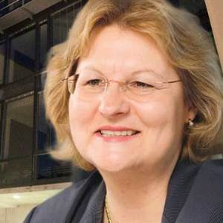
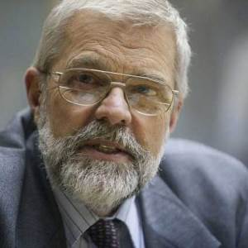
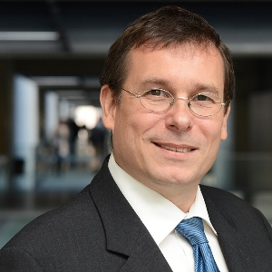
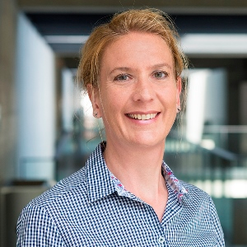
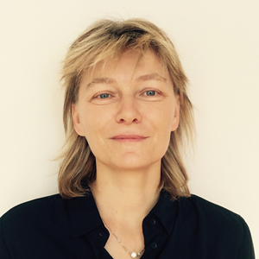
Why doing your Master in Management in Fribourg?
Our department:
Chair of Accounting
and Financial Analysis
Prof. Franck Missionier-Piera
Chair of Finance
and Corporate Governance
Prof. Dusan Isakov
Chair of Finance
and Accounting
Prof. Martin Wallmeier
Chair of Managerial
Accounting and Control
Prof. Michael Burkert
Chair of
Management
Prof. Rudolf Grünig
Chair for International
Management
Prof. Dirk Morschett
Chair of NPO Management
Prof. Markus Gmür
Chair of Human
Resources and
Organization
Prof. Davoine
Chair of Management
in Information and Communication Technology
Prof. Stephanie Teufel
Chair of International
Strategy and Competition
Prof. Pawel Dembinski
Chair of
Marketing I
Prof. Olivier Furrer
Chair of
Marketing II
Prof. Silke Bambauer-Sachse
Chair of Strategic
Entrepreneurship
Prof. Emmanuelle Fauchart

Slide 8
Why doing your Master in Management in Fribourg?
The strengths and unique characteristics of our department and our masters:
✓
International research that is continuously integrated in the master courses
✓
Cooperation with companies: projects, guest speaker presentations in the courses
✓
Highly motivated professors: We love teaching and interacting with our students!
✓
Excellent study conditions: optimal class sizes, individual supervision, great atmos-phere in class (intensive and respectful in-teraction, fairness and transparency, feed-back culture); in Fribourg, you are not just a number

Slide 9
Why doing your Master in Management in Fribourg?
What do our master students say?
→ extracted from recent master course evaluations
« intéressant, bon climat qui incite la participation »
«very good and clear course structure»
«Beaucoup d'exemples pour aider à comprendre la matière»
«interesting group work with good support from the professor»
«motivating interaction between the professor and the students»
«professor has an impressive know-ledge in the field»
«sympathischer und kompetenter Dozent»
«Thanks for all the guidance, knowledge, advise and support through the semesters.»
«Ich finde es grossartig, wie Sie sich für die … Studenten einsetzen.»
«very competent professor»
«very interesting examples that support theory application»
«Guest presentations were very insightful for me»
«enthusiastic teaching»
«I was very lucky to have had a professor, who cares for his students, inspires them and encourages them to do their best»
«I always felt supported by you all. Thank you.»
«I studied in Fribourg because I wanted a more 'personal' study environment.»

Slide 10
Why doing your Master in Management in Fribourg?
The strengths and unique characteristics of our department and our masters:
✓
✓
International research that is continuously integrated in the master courses
Studying in 3 languages: master courses in German, French, and English
✓
✓
Cooperation with companies: projects, guest speaker presentations in the courses
Intercultural experience: students from more than 50 countries, multicultural group work projects
✓
✓
Highly motivated professors: We love teaching and interacting with our students!
International mobility: attractive exchange programs, top destinations, individual sup-port, double degree programs
✓
Excellent study conditions: optimal class sizes, individual supervision, great atmos-phere in class (intensive and respectful in-teraction, fairness and transparency, feed-back culture); in Fribourg, you are not just a number

Slide 11
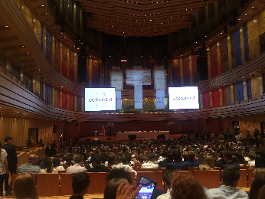
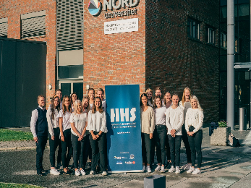
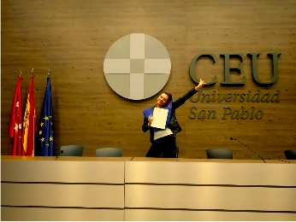
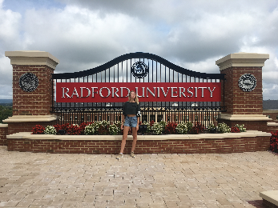
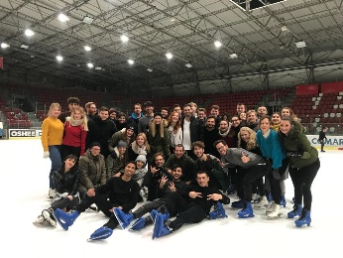
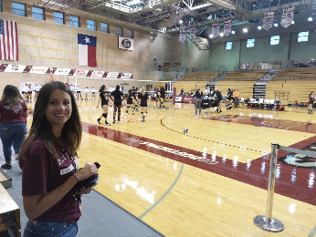
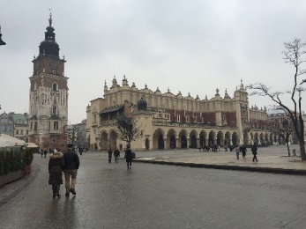
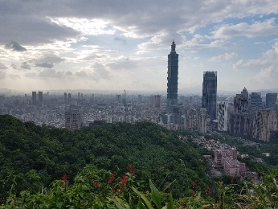
Why doing your Master in Management in Fribourg?
We recommend you to spend at least one semester abroad – Some popular destinations of our students:
Berlin
Hongkong
Munich
Taiwan
Madrid
Sydney
Barcelona
Lisbon
Valencia
Bodø
Texas
Linköping
Virginia
Vilnius
Strasbourg
Krakow
Bordeaux
Paris
Budapest
Rome
Pavia

Slide 12
Why doing your Master in Management in Fribourg?
The strengths and unique characteristics of our department and our masters:
✓
✓
International research that is continuously integrated in the master courses
Studying in 3 languages: master courses in German, French, and English
✓
✓
Cooperation with companies: projects, guest speaker presentations in the courses
Intercultural experience: students from more than 50 countries, multicultural group work projects
✓
✓
Highly motivated professors: We love teaching and interacting with our students!
International mobility: attractive exchange programs, top destinations, individual sup-port, double degree programs
✓
✓
Excellent study conditions: optimal class sizes, individual supervision, great atmos-phere in class (intensive and respectful in-teraction, fairness and transparency, feed-back culture); in Fribourg, you are not just a number
Flexibility: customize your master program according to your personal interests and study objectives

Slide 13
Why do your Master‘s degree in Management in Fribourg?
Our new master modules with selected courses:
(choice of > 10 courses in each module!)
Strategy
Innovation & Entrepreneurship
Organisation and
Human Resource
Management
Marketing
European and Global Business
Strategic Value Creation
Strategisches Projektmanagement
Case Studies in International Strategy
Leading Consulting Projects
Management of Innovation
Entreprenariat
Innovations- und Technologiemanagement
Nouveaux Trends de l‘Innovation
Organization Behavior
Strategisches HRM
Théories et pratiques de l‘organisation
Intercultural Management
Marketing Strategy
International Services Marketing
Retail and Distribution Management
Marketing Durable
Fundamentals of International Management
Managing the Multinational Network
Intercultural Business Projects
Sustainable Globalization
Finance
Accounting & Control
Nonprofit Management & Sustainability
Managing Digitalisation
Data Analytics
International Finance
Risk Management and Financial Derivatives
Finance empirique
Financial Statement Analysis
Advanced Managerial Accounting
Advanced Group Accounting
International Accounting Standards
International Taxation
Performance Measurement in NPO
Ressourcenmanagement in NPO
Das Freiburger Management-Modell
Sustainable Globalization
Digitalisation and Information Systems
Digital Commerce in B2C and B2B Markets
Big Data Methods
Digital Economy
Datenbanken
Machine Learning with Python
Econometric Methods and Applications
Méthodes de Classification

Slide 14
Choice of 4 Business Master Programmes
!NEW!
Master
in Accounting & Finance
Master
in International & European Business
Master
in Marketing
Our specialised programmes:
Master
in Management
Our broad and diversified programme:
We regularly evaluate and improve the quality of our master programs based on student feedback and external benchmarking.

